Slide 1
Single-cell, single-molecule RNA quantification of toxin-antitoxin gene expression in E.coli
Investigating toxin-antitoxin systems gene expression under different growth conditions
Florence Berbain, MSc. BSB, 2024
Supervision: Dr. Evelina Tutucci and Prof. Dr. Frank Bruggeman
Examiner: Dr. Matti Gralka

Slide 2
Persister cells
A subpopulation of cells that enter a dormant state in which they stop growing
Transient behavior: persister cells can resume growth at some point in time
Causes antibiotic persistence (chronic infections)
Facilitates the evolution of antibiotic resistance (mutation)
Stress is a trigger (e.g. lack of nutrients, high cell number, acid stress)
Toxin-Antitoxin systems might be involved
Notes:
Persister cells are a subpopulation of cells that enter a dormant state in which they stop growing
This behavior is transient, so these cells can resume growth at some point in time
Antibiotic persistence plays an important role in chronic infections and facilitates the evolution of antibiotic resistance. In contrast to resistance, in which a heritable genetic change renders an entire bacterial population able to grow in the presence of an antibiotic, persister cells are genetically identical to their susceptible relatives and they tolerate antibiotics and other stresses by entering a transient, non-replicating state^{15,16}. Persister cells can resume normal growth once the stressor is removed, but they are once again sensitive to the stress¹⁶. Persistence is viewed as a bet-hedging strategy against unexpected environmental threats; the dormant cells temporarily sacrifice replication in exchange for stress tolerance
​
Why do we care about this phenomenon?​
antibiotics only kill growing cells, not dormant cells​
so persisters might play a role in relapsing infections that successfully evade antibiotics action ​
examples: tuberculosis, lung infections in cystic fibrosis patients, Salmonella, tonsillitis, urinary tract infections​
​ About persistence, we know that:​
stress can trigger persistence (nutrient limitation, high cell number, acid stress, immune factors) ​
Toxin-Antitoxin systems might be involved​
About persistence, we don’t know:​
the molecular mechanism of tolerance that enables the persister bacteria to survive​
the mechanism that generates heterogeneity in the population​
​
==========================================================================================================================================
Bacterial cells can become resistant to antibiotics by acquiring mutations, but can also escape killing by antibiotics by switching to a so-called ‘persister’ state (Lewis 2010^{i}, Berkvens et al. 2022 ^{ii}). Cells in the persister state go dormant: they stop growing, or grow only very slowly. Since antibiotics can only kill growing cells, because they work by interfering with the growth processes, the subpopulation of persister cells is tolerant to antibiotics and can restart growing once the antibiotic treatment is ended.
Acquiring a better understanding of persistence mechanisms is crucial, as resistance to antibiotics is a major, mounting problem in the treatment of infectious diseases. Since persister cells are a subgroup of the general population, understanding which cells become persistent and how they become persistent requires single cell analysis.

Slide 3
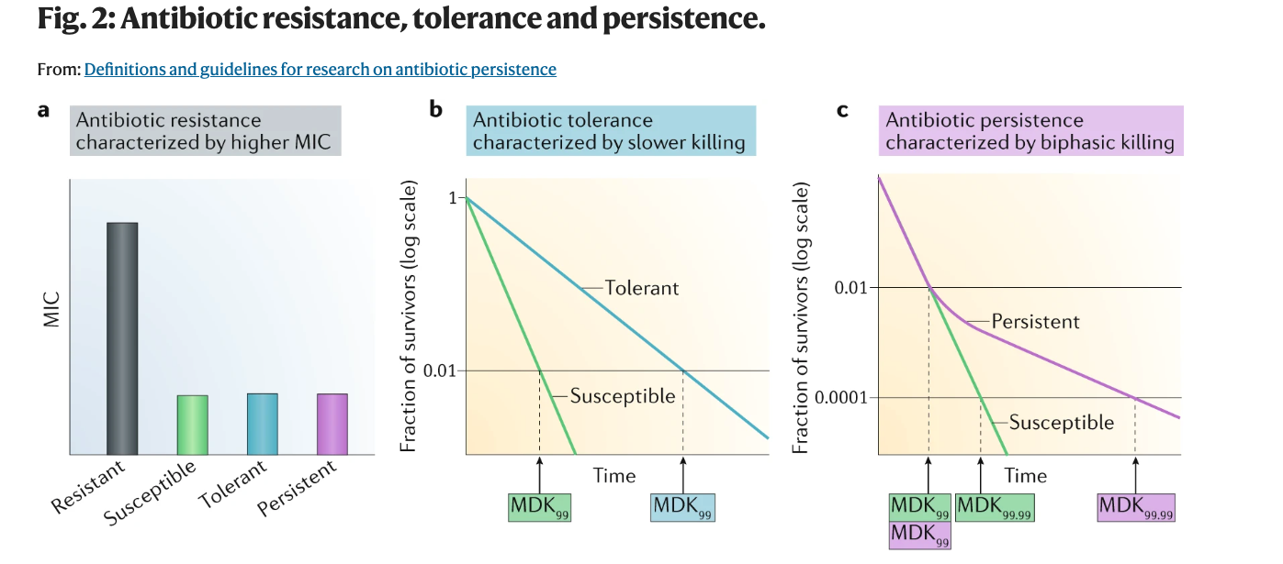
Resistance – Tolerance - Persistence
Balaban2019
resistance = need more drug to kill – higher MIC (Minimum Inhibitory Concentration)
tolerance = slower killing for the whole population – longer MDK (Minimum Duration for Killing)
persistence = slower killing for part of the population- biphasic killing curve – MDK99,99 >>> MDK99
Notes:
resistance = need more drug to kill – higher MIC (Minimum Inhibitory Concentration)
tolerance = slower killing for the whole population – longer MDK (Minimum Duration for Killing)
persistence = not all cells are killed at normal pace - biphasic killing curve – MDK99,99 >>> MDK99
Caption: Resistance is caused by a mutation and leads to a higher MIC, tolerance leads to longer MDKs, and persistence is characterized by a biphasic killing curve due to population heterogeneity, as the persister fraction of the population is insensitive to the action of the bacteridal agent

Slide 4
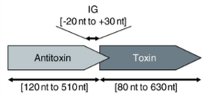
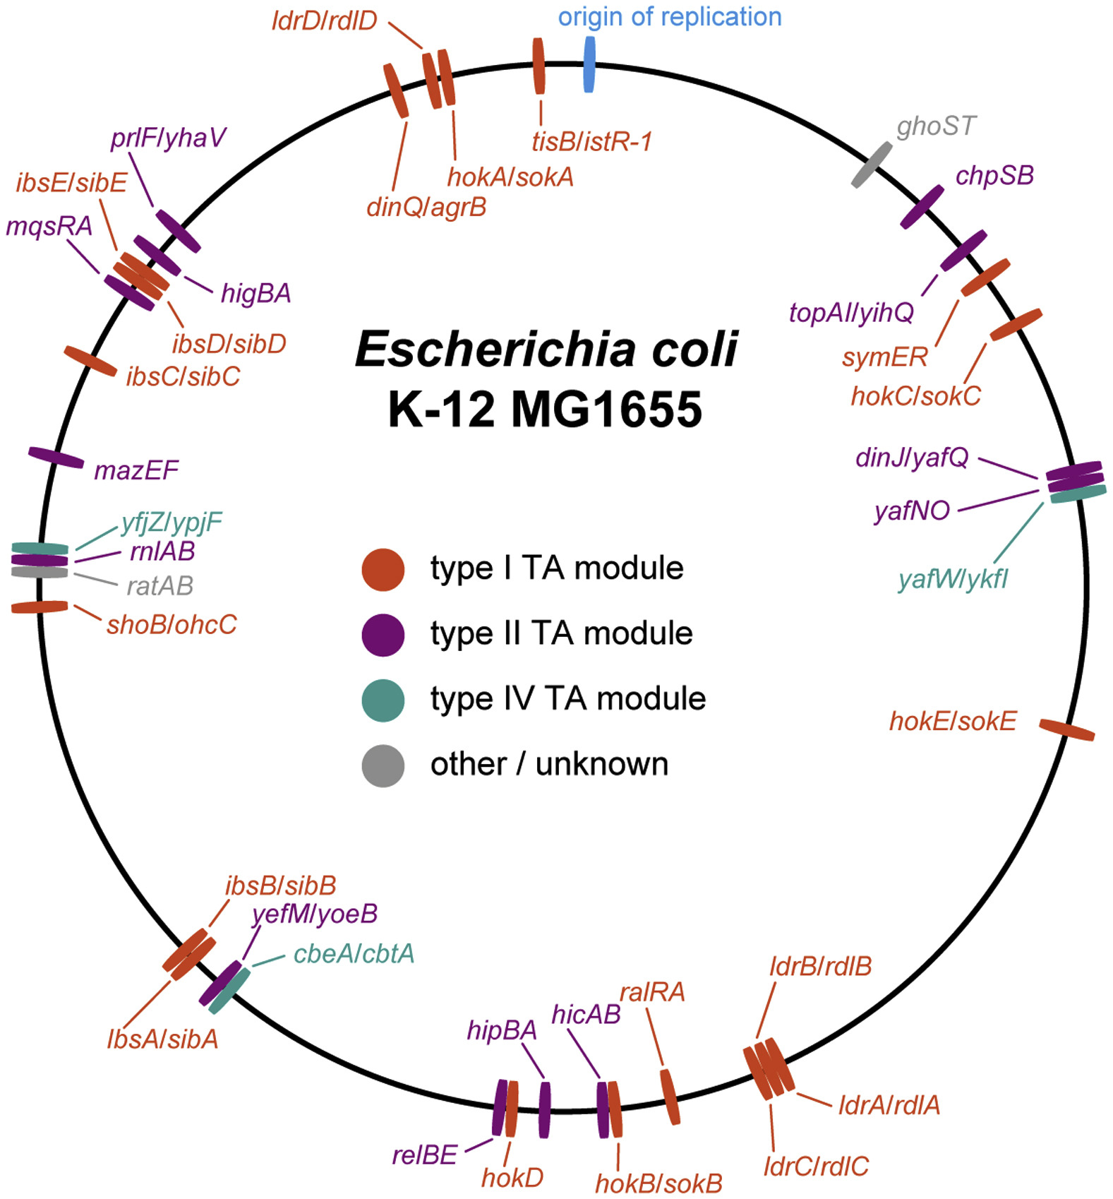
TA systems
Multiple TA systems on the E.coli bacterial genome
TA module = a small operon that encode a toxic protein and a corresponding antitoxin (typically upstream)
The antitoxin can be a protein or an RNA molecule
In type II TA systems, the antitoxin is a protein that binds to the toxin to neutralize it
Toxin is stable, antitoxin is labile and degraded by proteases
Antitoxin and TA complex repress their own transcription: less AT => more transcription
https://doi.org/10.1016/j.molcel.2018.01.003
Notes:
Polycistronic transcripts
Translation: Termination-Reinitiation mechanism (ribosome large subunit fall soff at the end of the first transcript, then small subunit recruits a new large subunit)
========================================================​
About TA modules, we know that:​
there are multiple TA modules in the E. coli bacterial genome​
a TA pair is composed of a toxin, that causes growth arrest by interfering with a vital cell process, and an antitoxin that neutralizes the toxin’s action​
there are several types of TA modules, type II systems are the best known and are usually located on the same operon.​
​
=======================================================​
Toxin-antitoxin modules consist of pairs of genes that are usually located on the same operon.
TA gene products consist of a toxin, which is usually a protein, and an antitoxin, which is either a protein or an RNA molecule. The toxin causes growth arrest by interfering with a vital cell process, such as protein synthesis. Under normal conditions, the cognate antitoxin is expressed, and blocks the toxin activity. Under stress conditions, the antitoxin can be degraded, and high toxin levels lead to growth arrest.
Analogy: lemon on a ship. Once lemon/vitamin C runs out, everyone gets scurvy.
There are currently 8 known types of TA systems classified by the nature of the toxin and antitoxin molecules, and how the antitoxin inhibits the action of the toxin. The first four types are the most common, of which type I and type II systems have been widely studied in the context of persister formation (Harms et al. 2016 ^{iv}).
Type I antitoxins are small RNAs that block the translation of the mRNA of their cognate toxins.
Type II systems are generally better understood than type I systems. In a type II TA system, both the toxin and the antitoxin are proteins. The toxin is stable whereas the antitoxin is labile, with the antitoxin inhibiting the action of the toxin by tightly binding to it. Type II systems are organised in operons with the antitoxin typically being located upstream of the toxin, which helps to prevent expression of the toxin without the antitoxin.
In type III systems, the antitoxin RNA directly binds and inhibits the protein toxin, forming a neutralising protein-RNA complex.
Type IV antitoxins and toxins are both proteins, like for type II, but the antitoxin works by preventing the toxin from binding its target, instead of by directly binding to the toxin. (Page et al. 2016, Harms et al. 2016).
=======================================================
Toxin-antitoxin (TA) modules are small operons that encode a toxic protein and a corresponding antitoxin¹. In Type II TA systems, the antitoxin is a protein that binds and neutralizes the toxin². When free of inhibition, the toxin acts on various targets to inhibit cell growth or cause death³. While the toxin is long-lived, the antitoxin is labile and degraded by proteases. Therefore, the antitoxin must be continually produced to keep the toxin in check⁴. Both the antitoxin alone and the toxin-antitoxin complex can repress their own transcription; thus, as the antitoxin is degraded, the repression is relieved and the operon is transcribed to replenish the antitoxin supply.
Caption: The E.coli genome contains multiple TA systems, distributed over the whole length of the bacterial chromosome

Slide 5
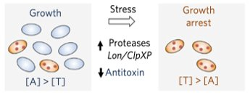
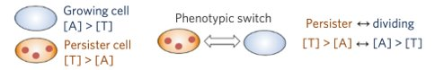
Phenotypic switch
Antitoxin is degraded by proteases
High toxin level => more persisters
Page2016
Rotem2010 :
Bacterial cells become dormant if the toxin level is higher than a threshold
The amount by which the threshold is exceeded determines the duration of dormancy
Notes:
​How do cells enter and exit the persister state​
​
Hypotheses:​
[A], [T], [AT] => persistence level​
[A], [T], [AT] => growth rate => persistence level
Rotem2010: -
Fluctuations in toxin levels above and below the threshold result in coexistence of dormant and growing cells. We conclude that toxin–antitoxin modules in general represent a mixed network motif that can serve to produce a subpopulation of dormant cells and to supply a mechanism for regulating the frequency and duration of growth arrest. Toxin– antitoxin modules thus provide a natural molecular design for implementing a bet-hedging strategy.
Caption: Persister cells are genetically identical to non-persister cells, and result from a phenotypic switch. Switching happens when the toxin concentration exceeds a threshold. The amount by which the threshold is exceeded determines the duration of dormancy.
Check resolution

Slide 6
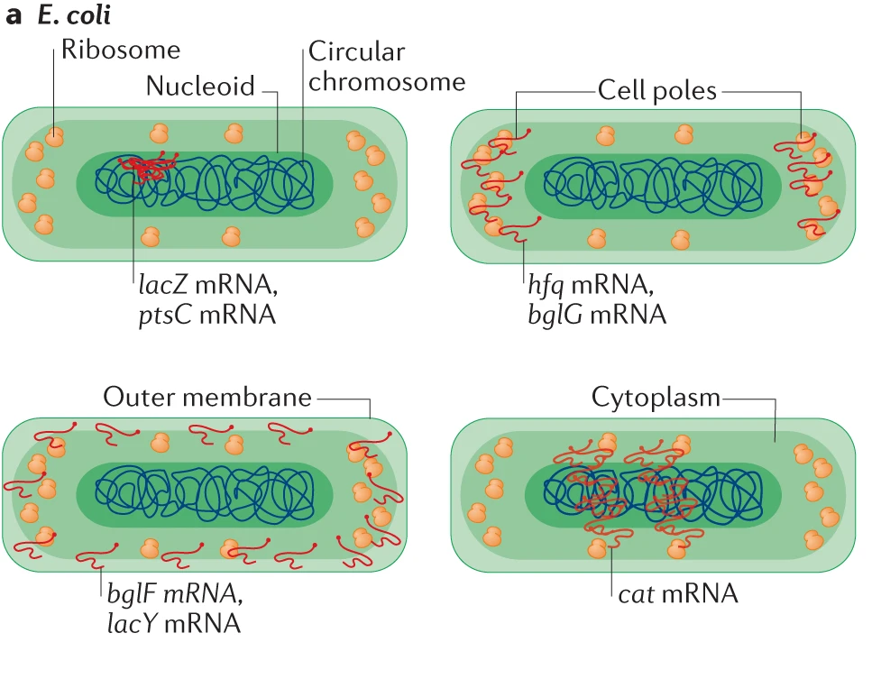
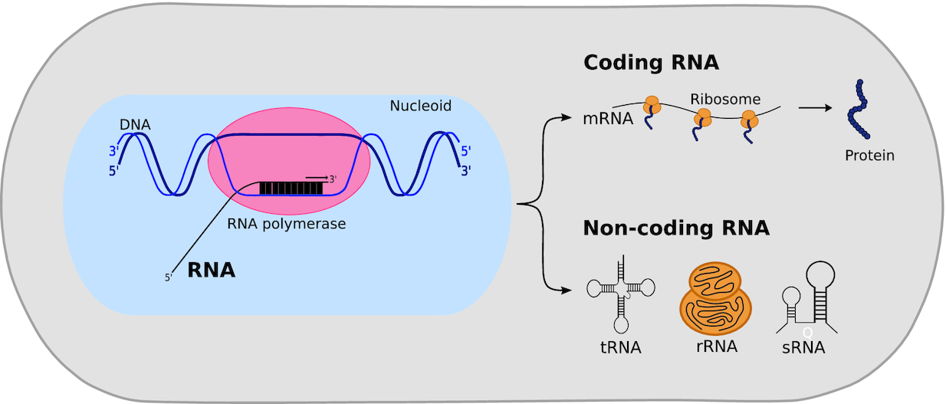
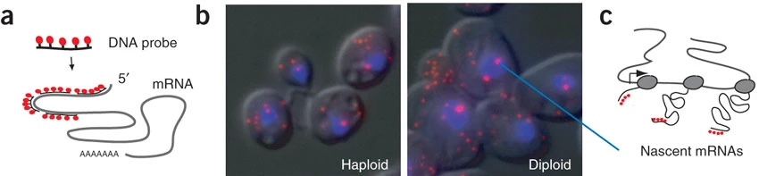
mRNA quantification and localization: smFISH
https://doi.org/10.1093/femsre/fuaa051
https://doi-org.vu-nl.idm.oclc.org/10.1038/s41580-021-00356-8
https://doi-org.vu-nl.idm.oclc.org/10.1038/nsmb.1514
Notes:
Figure 1. Synthesis of coding and non-coding RNA species in bacteria during transcription. In bacteria, both coding and non-coding RNA is synthesized from double-stranded DNA by RNA polymerase, presumably in the nucleoid periphery, in the process of transcription. Coding RNA or messenger RNA (mRNA) is translated to proteins by ribozymes, presumably in the nucleoid periphery as well. Non-coding RNA, such as transfer RNA (tRNA), ribosomal RNA (rRNA) and other small regulatory RNA (sRNA), will fold into distinct nanostructures and will play a role in downstream processes such as translation and gene expression regulation.
Skinner smFISH protocol The measured mRNA copy number distribution obtained from many individual cells can be used to extract the parameters of stochastic gene activity, namely the frequency and size of transcription bursts from the gene of interest.
Bulk: northern blotting, qPCR and microarrays
Single cell: RNAseq
Single cell with dynamics (in live cells) and subcellular localization: imaging-based methods
Eukaryotes: transcription in the nucleus, translation in the cytoplasm
Bacteria: only one compartment. Transcription-translation coupling. Nevertheless, some spatial patterns of subcellular localization.
mRNA localization contributed to the post-transcriptional fine-tuning of gene expression and the control of fundamental processes such as cell migration, polarization and differentiation.

Slide 7
This project
Goal:
Measure mRNA levels at various growth rates
Variable: growth rate (carbon source in [glucose, glycerol, galactose, mannose])
Genes: rpoD, hipBA, rnlAB
Optimize existing bacteria FISH protocol
Establish the analysis pipeline
Question:
How do TA systems and rpoD expression change with growth rate?
Expectation:
rpoD is growth regulated whereas the TA systems are not

Slide 8
Previous project (Merve 2022)
smFISH with two genes
rpoD (growth)
hipBA (”hip” = “high persistence”; HipA is known to cause persistence)
Testing several conditions, with and without stress:
Medium: LB vs. M9
pH: pH7 vs. pH5
Temperature: 37°C vs. 42°C
Findings:
More non-expressing cells in M9
No significant correlation between rpoD and hipBA expression
Some cells with no rpoD expression and hipBA expression
Notes:
3 color smFISH: add one target TA system
rethink conditions
adapt FISH picture analysis pipeline for E.coli

Slide 9
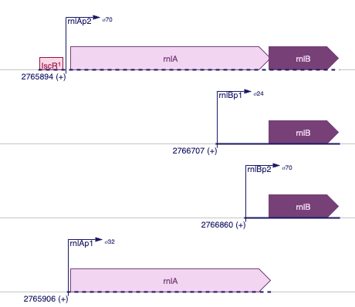
smFISH targets
rpoD: σ factor in exponential phase
HipA: serine/threonine kinase, activates ppGpp synthesis -> growth arrest
RnlA: endoribonuclease involved in defense against bacteriophage T4, involved in cellular mRNA degradation
Source: Ecocyc
Notes:
rpoD: σ factor in exponential phase
hipBA:
HipA:
serine/threonine kinase
activates ppGpp synthesis -> growth arrest
rnlAB:
RnlA:
endoribonuclease involved in defense against bacteriophage T4
involved in cellular mRNA degradation
Caption: Both hipBA and rnlAB are Type II TA systems. HipA is a serine/threonine kinase that activate ppGpp synthesis by RelA and leads to growth arrest. RnlA is an endoribonuclease involved in defense against some mutants of bacteriophage T4, and also plays a role in cellular mRNA degradation.
…rest of the info + “All of this has consequences for probe design, see infra.”

Slide 10
Probes
Gene | Length (bp) | Function | Fluorophore
rpoD | 1842 | Exponential phase growth (σ⁷⁰) | Q570
rnlAB | 1437 | TA system | Cal610
hipBA | 1589 | TA system | Q670
p1
rnlAp2
DNA oligo
fluorophore
rnlBp2
rnlA
rnlB
48 probes * 20 bp
2 promoters
Notes:
transcription units are polycistronic transcripts
unusual order
second promoter for rnlB
why we could maybe expect to see two peaks in spot intensity

Slide 11
Rethink conditions
LB is not suitable for physiological experiments
in LB carbon sources are catabolizable amino-acids, not sugars
exponential growth stops at OD=0.3
beyond 0.3, the physiological state of the cells varies constantly
this can cause reproducibility problems
Barebones M9 lacks some nutrients E.coli requires
growth might be limited by other factors than carbon availability
e.g. Jensen1993 MG1655 starves for pyrimidine
switch to supplemented AB medium
Supplement with:
trace elements
thiamine
uracil
Notes:
Conditions
Previously: stress versus no stress
Variables: medium, temperature, pH

Slide 12
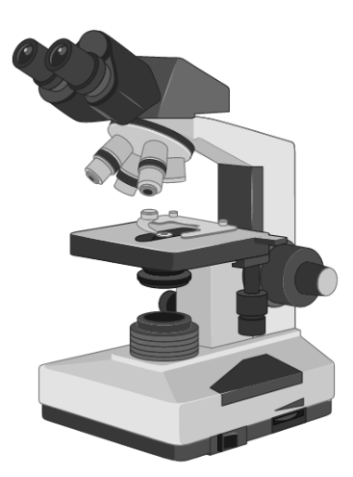

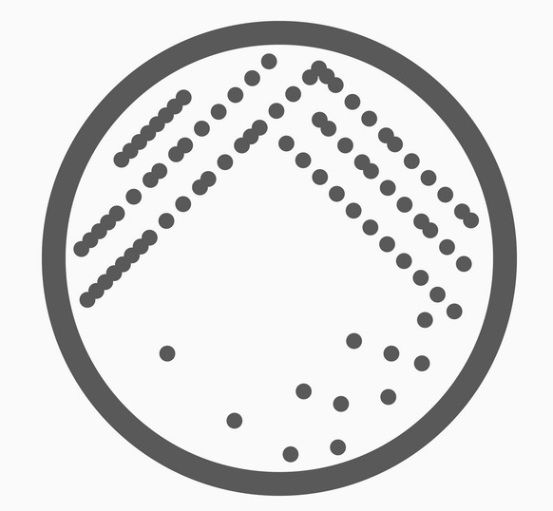


smFISH protocol
Quasar 670
5’
mRNA
DNA oligo
LB agar
3’
LB
PFA
AB medium +
thiamine, TE, uracil +
carbon source
probes
Protocol: Agar plate -> seed culture in 10mL LB in Greiner tube -> overnight culture in 25mL target media in 250mL shake flask -> fix cells at OD=0.3 (i.e. in exponential phase) -> hybridize -> image -> analyse

Slide 13
Growth rates
glucose: μ = 0.54
glycerol: μ = 0.32
galactose: μ = 0.17
mannose: μ = 0.12
Basan2020: MG1655 mu Glu=0.9, Gly 07, Gal 0.6, Man 0.5
Soupene2003: MG1655 mu Glu=0.6, Gly 0.4
Different growth defects in different MG1655 variants
Some strains adapt to galactose and then grow faster
Notes:
Issues with plate reader
Issues with LB repeatability
Synchronise LB and M9 in the initial experiments
Discard pH and temperature conditions
Machine lost data for non-standard experiment duration
Condensation
Issues with shake flasks
lag phase between LB and M9 are very different => hard to synchronise and get the overnight culture right
Explanation: age of the agar plate, dilution levels too high, dilution errors
Issues with both:
remain strictly within exponential phase at all times

Slide 14
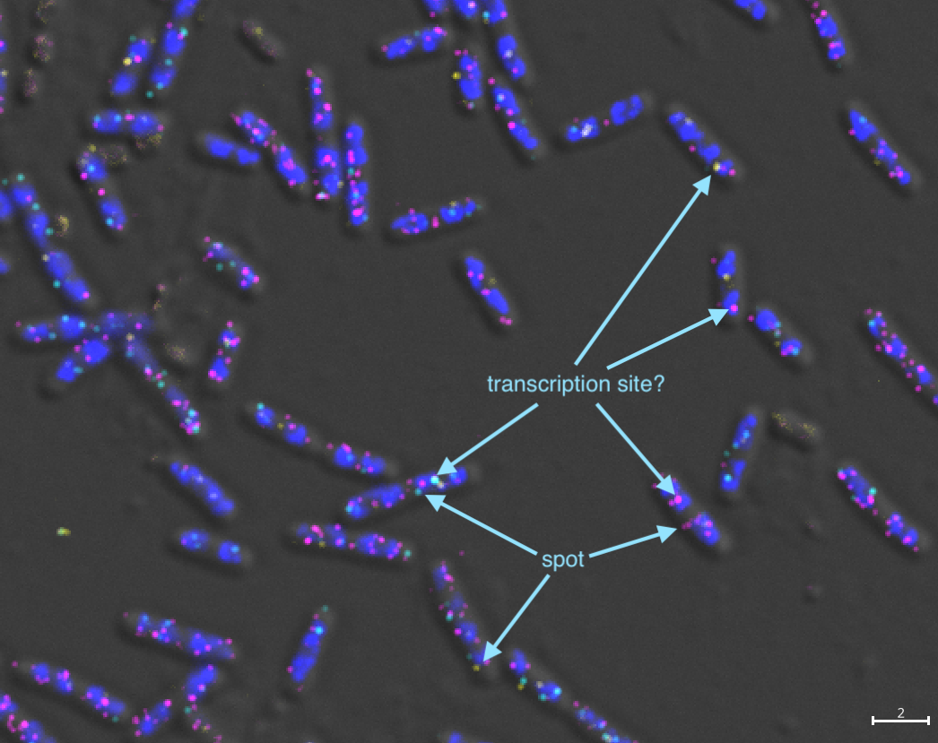
LB
DIC DAPI rpoD rnlAB hipBA scale bar: 2 µm

Slide 15
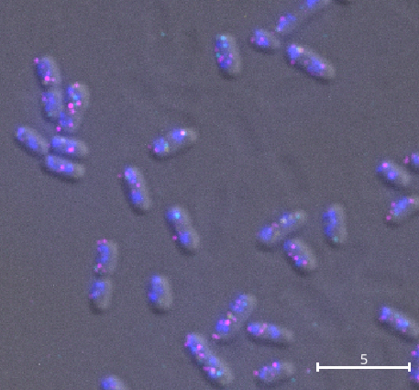
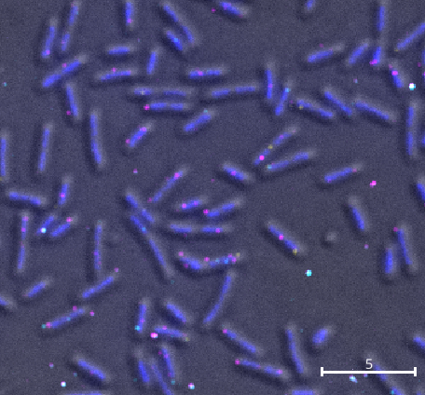
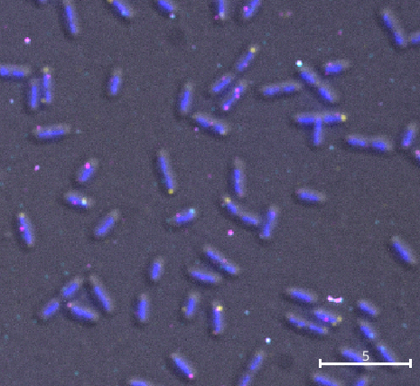
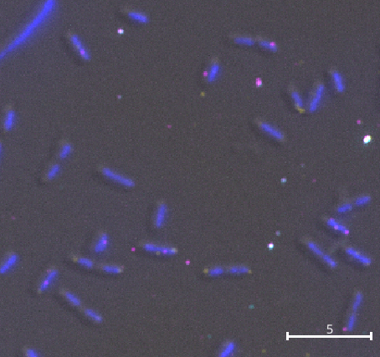
DIC DAPI rpoD rnlAB hipBA scale bar: 5 µm
GLU
GLY
LB
GAL
MAN
Notes:
larger pictures
write “bar = 5 µm”
add grey=DIC
add bar with colours at the top (saves space)
Caption: From left to right, glucose, glycerol, galactose, and mannose FISH pictures. Spots for all three genes are observed in all conditions. mRNA counts differ from cell to cell, which is expected since mRNA copy number vary stochastically wihtin a population of genetically identical cells. Spot frequency for a given mRNA also seems to vary across conditions. The frequencies for the two TA systems is signficantly higher than the expected frequency of persister cells, underscoring that TA system transcription alone is not enough for the toxin to be activated.

Slide 16
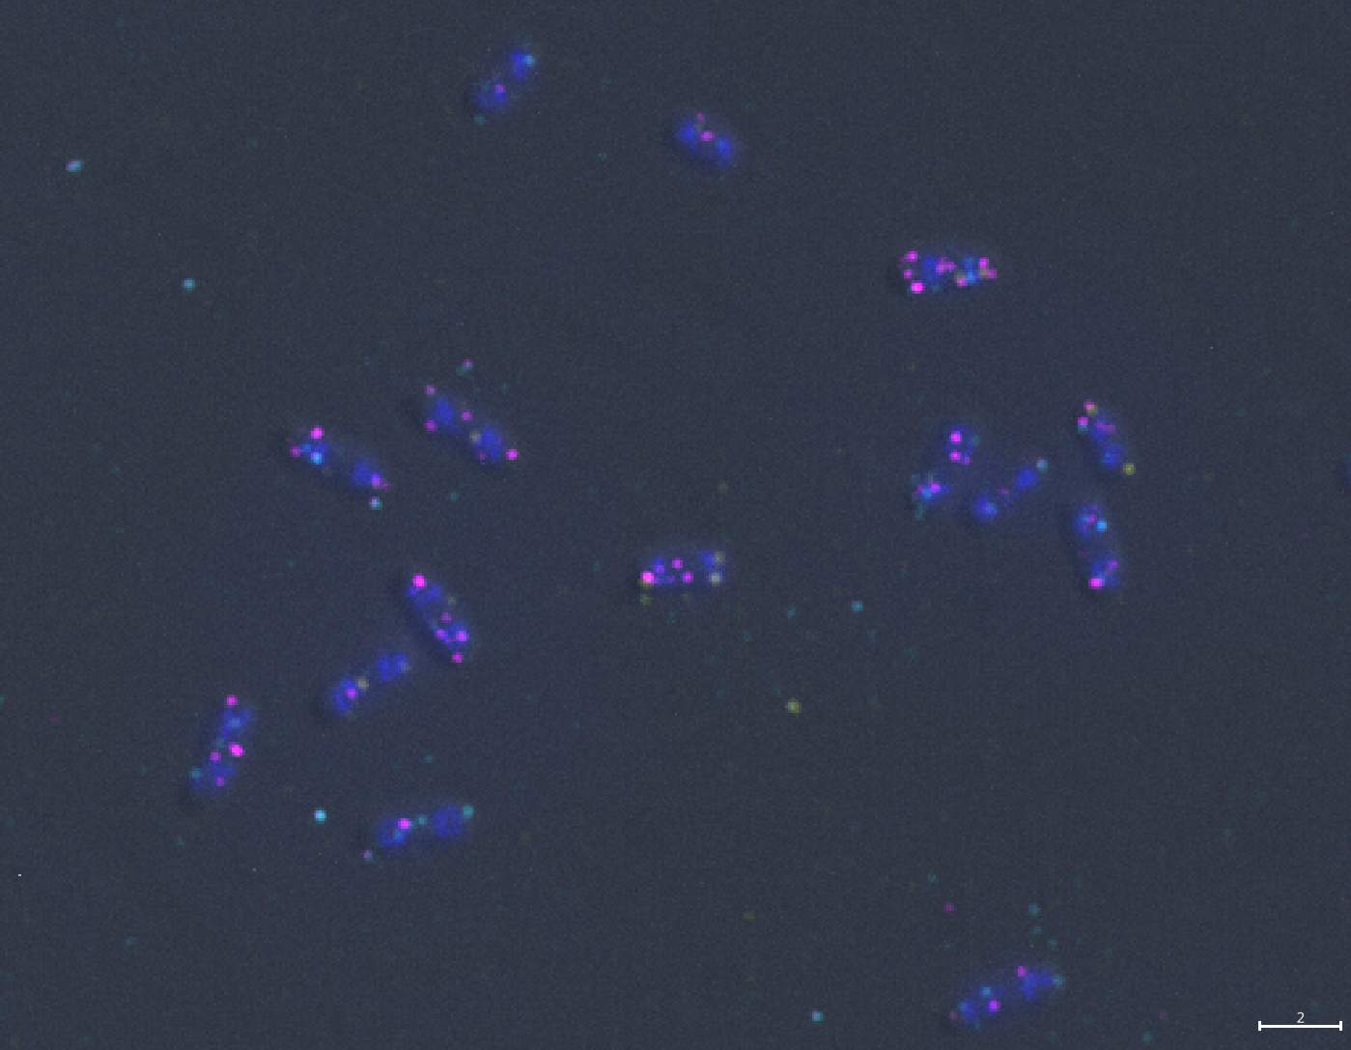
Analysis pipeline
For each channel:
remove backgound noise ✅
detect spots
decompose spots
assign to cell mask
count
DIC picture:
segment
postprocess

Slide 17
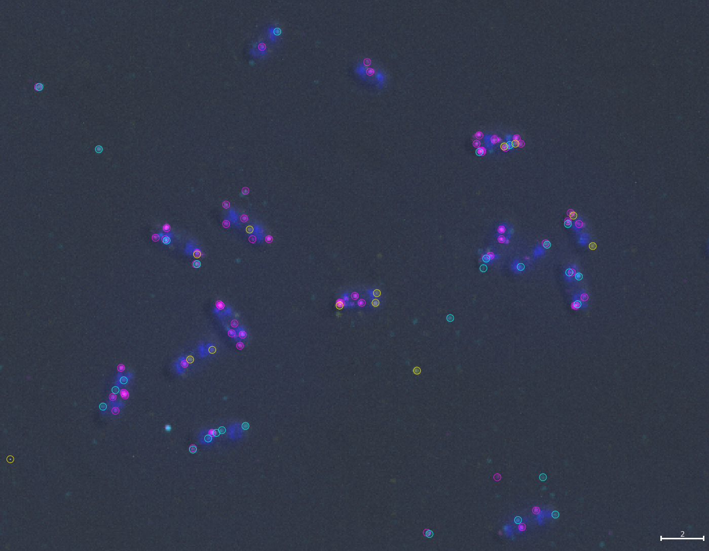
Analysis pipeline
For each channel:
remove backgound noise ✅
detect spots ✅
decompose spots
assign to cell mask
count
DIC picture:
segment
postprocess

Slide 18
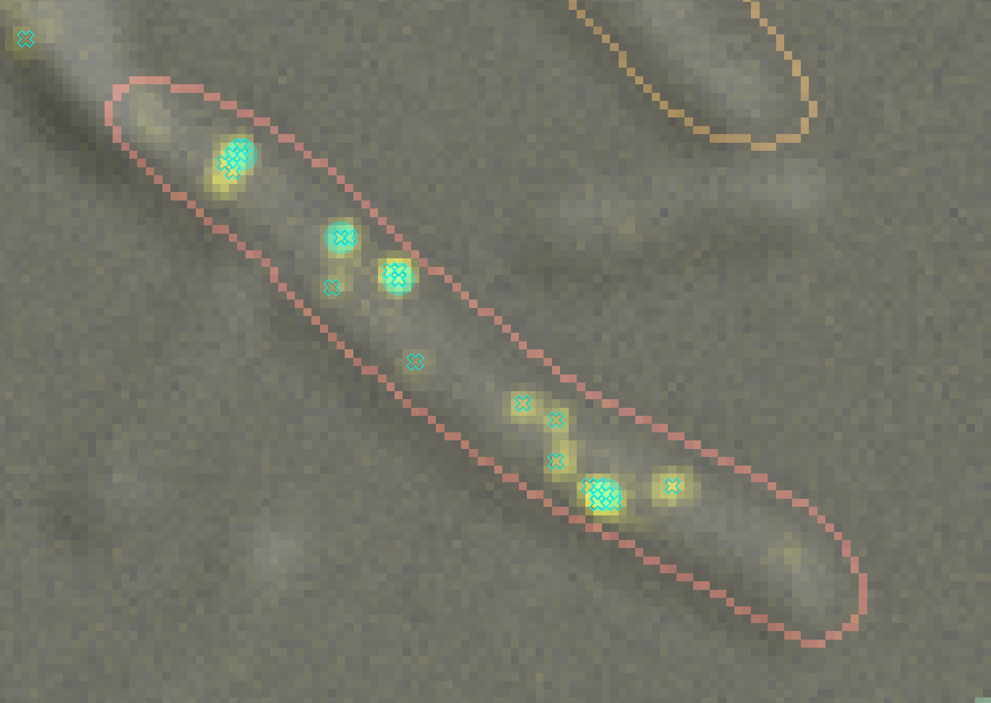
Analysis pipeline
For each channel:
remove backgound noise ✅
detect spots ✅
decompose spots ✅
assign to cell mask
count
DIC picture:
segment
postprocess
Notes:
Issue: spots are too close
Solution: estimate number of spots based on fluorescence intensity

Slide 19
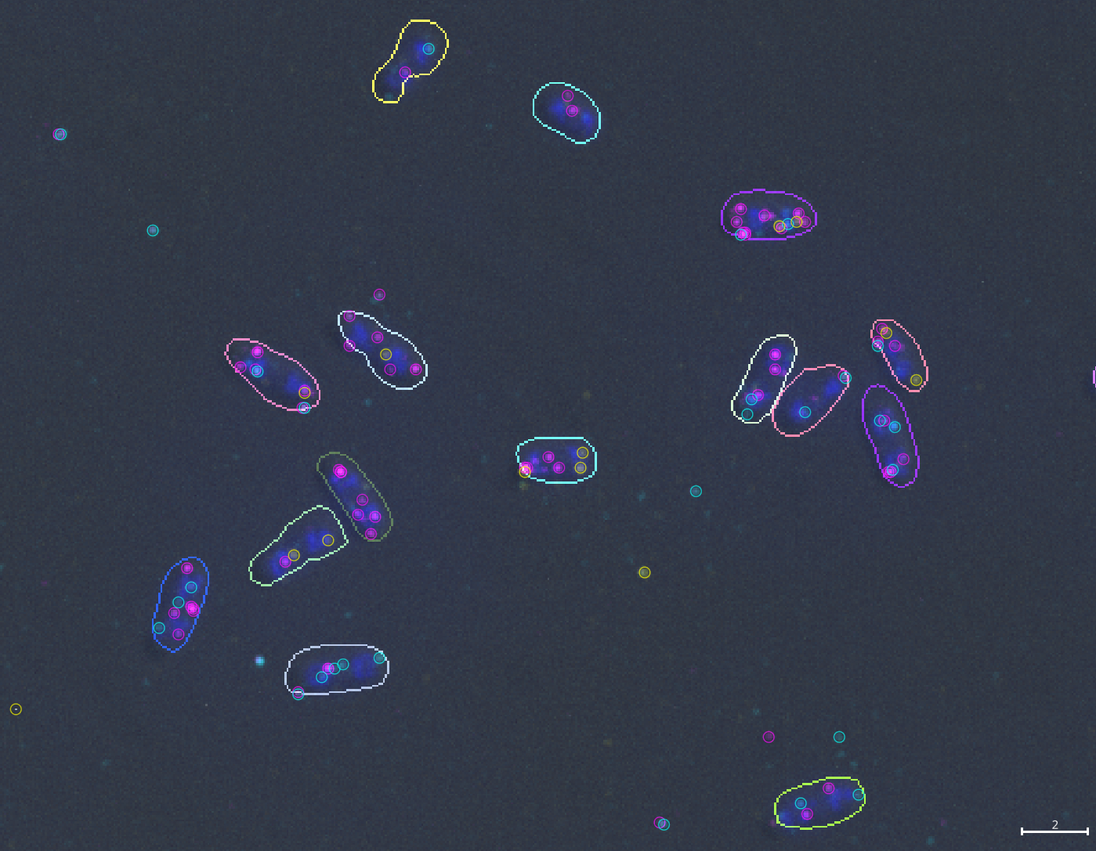
Analysis pipeline
For each channel:
remove backgound noise ✅
detect spots ✅
decompose spots ✅
assign to cell mask ✅
count ✅
DIC picture:
segment ✅
postprocess ✅
Notes:
DIC segmentation is useless.
Need brightfield or phase contrast images.
Otherwise we are just tracking the DIC shadows.

Slide 20
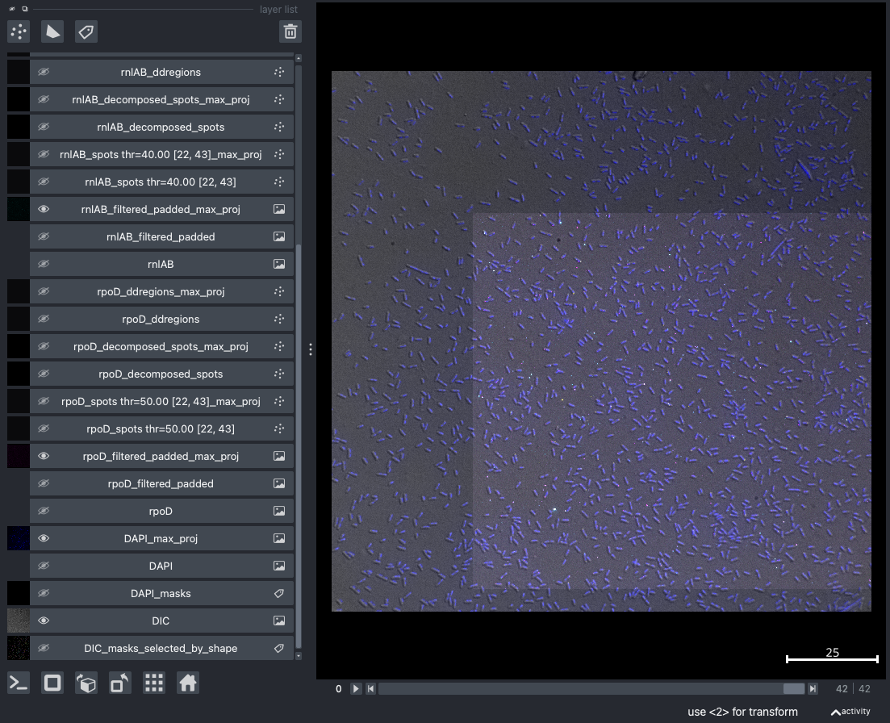
Tooling
multiple processing
#channels
#conditions
#pictures
tune
focus
filtering
threshold
record parameters
view layers

Slide 21
Spot frequencies
Notes:
Caption: To further check quality, we compare the intensities of spots found inside and outside of cells. Left column: z-slice where the spot was found, middle column: spot raw intensity, right column: filtered spot intensity. Top row: rpoD, middle row: rnlAB, bottom row: hipBA. For each plot, data is split into out-of-cell spots (salmon color) and spots that are located in a cell (green color). Out-of-cells spots are eliminated from the quantitative analysis. Too many out-of-cell spots will lead to a low signal to noise ratio, as the likelihood that a spot that was counted is actually a true spot decreases. Ideally we would like out-of-cell spots to have lower intensities overall than in-cell spots. For this picture, we do not observe separation between the two populations based on the intensities. However, the number of spots outside the cells is significantly lower than inside. We also see that, especially for the two TA systems, out-of-cell spots tend to appear in slices that are at an extreme of the focus zone, pointing to a possible issue with the focus range chosen for analysis. False negatives from the segmentation will also increase the out-of-cells counts.
Mention the two peaks for rnlAB.

Slide 22
Spot intensities
in cell
out of cell
Notes:
Caption: To further check quality, we compare the intensities of spots found inside and outside of cells. Left column: z-slice where the spot was found, middle column: spot raw intensity, right column: filtered spot intensity. Top row: rpoD, middle row: rnlAB, bottom row: hipBA. For each plot, data is split into out-of-cell spots (salmon color) and spots that are located in a cell (green color). Out-of-cells spots are eliminated from the quantitative analysis. Too many out-of-cell spots will lead to a low signal to noise ratio, as the likelihood that a spot that was counted is actually a true spot decreases. Ideally we would like out-of-cell spots to have lower intensities overall than in-cell spots. For this picture, we do not observe separation between the two populations based on the intensities. However, the number of spots outside the cells is significantly lower than inside. We also see that, especially for the two TA systems, out-of-cell spots tend to appear in slices that are at an extreme of the focus zone, pointing to a possible issue with the focus range chosen for analysis. False negatives from the segmentation will also increase the out-of-cells counts.
Mention the two peaks for rnlAB.

Slide 23
Spot intensities
in cell
out of cell
Notes:
Caption: To further check quality, we compare the intensities of spots found inside and outside of cells. Left column: z-slice where the spot was found, middle column: spot raw intensity, right column: filtered spot intensity. Top row: rpoD, middle row: rnlAB, bottom row: hipBA. For each plot, data is split into out-of-cell spots (salmon color) and spots that are located in a cell (green color). Out-of-cells spots are eliminated from the quantitative analysis. Too many out-of-cell spots will lead to a low signal to noise ratio, as the likelihood that a spot that was counted is actually a true spot decreases. Ideally we would like out-of-cell spots to have lower intensities overall than in-cell spots. For this picture, we do not observe separation between the two populations based on the intensities. However, the number of spots outside the cells is significantly lower than inside. We also see that, especially for the two TA systems, out-of-cell spots tend to appear in slices that are at an extreme of the focus zone, pointing to a possible issue with the focus range chosen for analysis. False negatives from the segmentation will also increase the out-of-cells counts.
Mention the two peaks for rnlAB.

Slide 24
Spot intensities
in cell
out of cell
Notes:
Caption: To further check quality, we compare the intensities of spots found inside and outside of cells. Left column: z-slice where the spot was found, middle column: spot raw intensity, right column: filtered spot intensity. Top row: rpoD, middle row: rnlAB, bottom row: hipBA. For each plot, data is split into out-of-cell spots (salmon color) and spots that are located in a cell (green color). Out-of-cells spots are eliminated from the quantitative analysis. Too many out-of-cell spots will lead to a low signal to noise ratio, as the likelihood that a spot that was counted is actually a true spot decreases. Ideally we would like out-of-cell spots to have lower intensities overall than in-cell spots. For this picture, we do not observe separation between the two populations based on the intensities. However, the number of spots outside the cells is significantly lower than inside. We also see that, especially for the two TA systems, out-of-cell spots tend to appear in slices that are at an extreme of the focus zone, pointing to a possible issue with the focus range chosen for analysis. False negatives from the segmentation will also increase the out-of-cells counts.
Mention the two peaks for rnlAB.

Slide 25
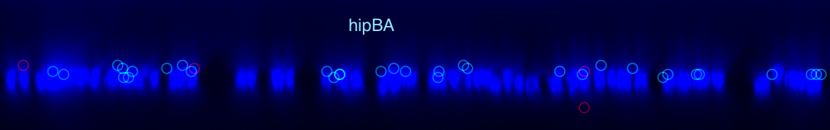
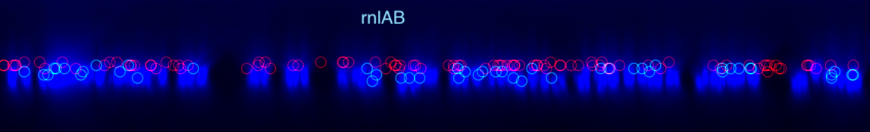
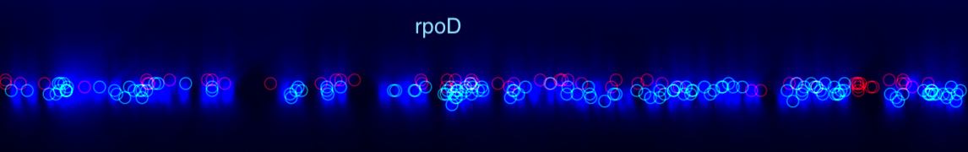
Slide view
Notes:
Caption: Detected spots that are deemed to be outside of cells are circled in red and discarded in the analysis, spots that are circled in cyan are deemed in-cell and counted for the analysis. The 3D DAPI signal is shown to hint at the approximate location of cells. The vertical dimension is the z-axis. Many red spots gather in the lower z-slices, as suggested by the Figure 14 plot. Manual examination of the 3D picture suggests that these spots are often rightfully discarded.

Slide 26
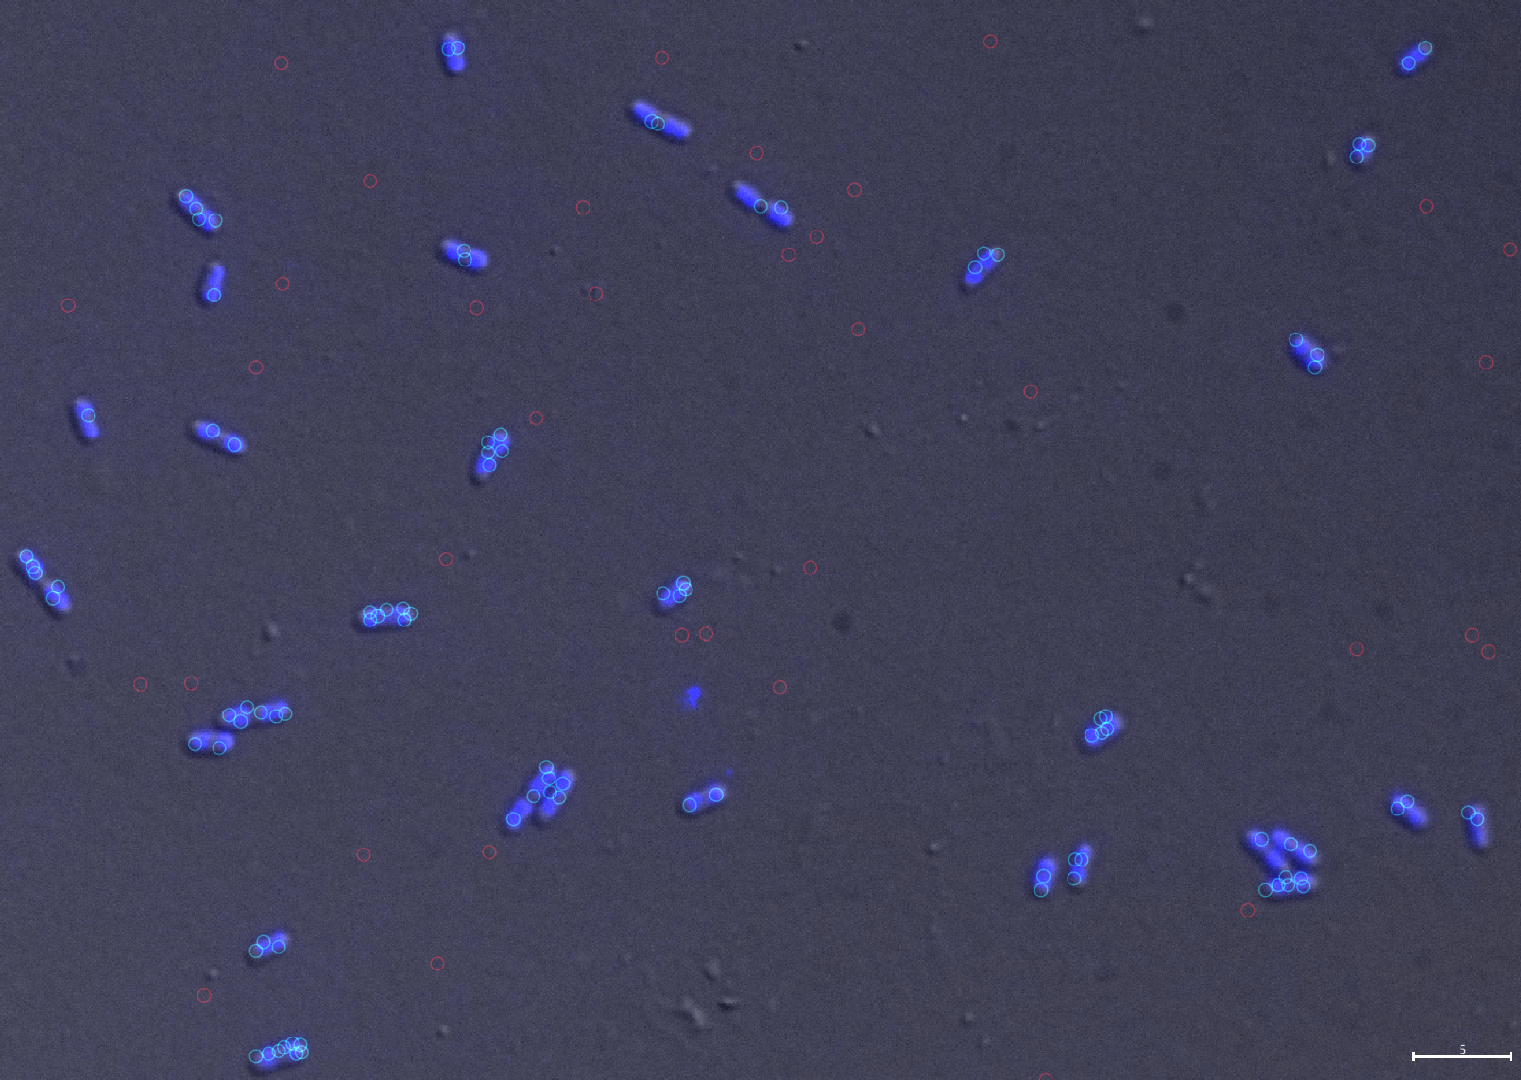
hipBA
rpoD

Slide 27
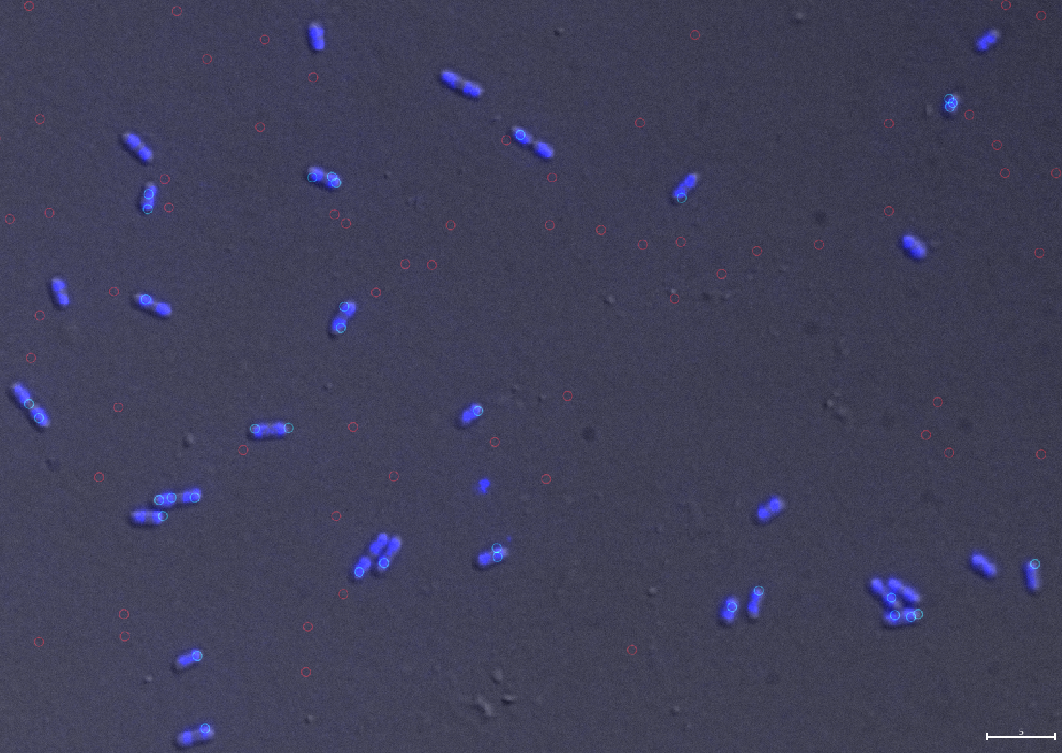
rnlAB

Slide 28
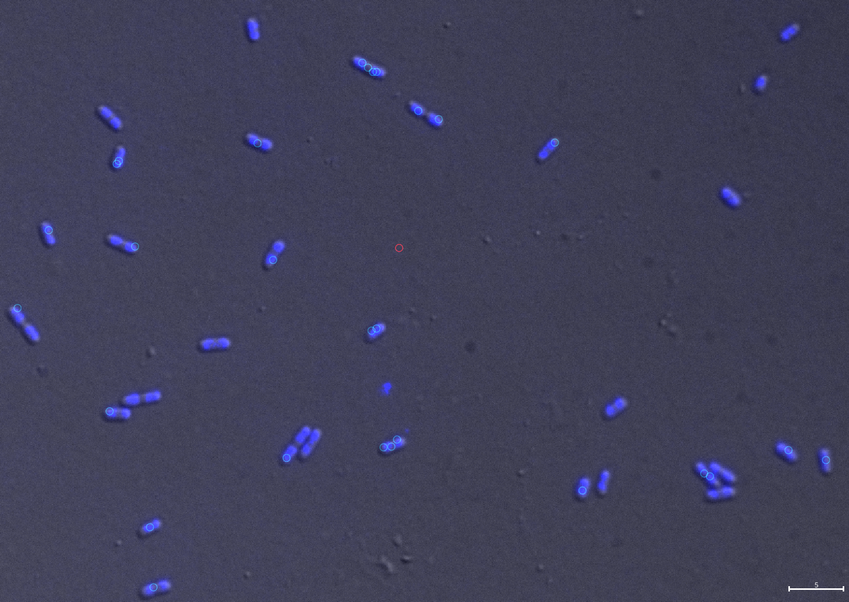
hipBA

Slide 29
Cell features
Cell size increases with growth rate
Cell eccentricity: irregular. Might be due to segmentation errors.
Notes:
update violinplot to unexpanded length for exp22+24
bootstrap analysis for mean
check whether volume scales exp. with mu; if not, we can’t use area/volume reliably
report numbers normalized by length
cell contours from brightfield or phase contrast
set x and ylabels
Full carbon source names/mu
add schematic with eccentricity and ellipse
Caption: Right: number of cells for each condition. Left and center: distributions of cell areas and eccentricities, split per condition. Cell area is measured as the number of pixels covered by the cell mask returned by segmentation. Cell eccentricity is inferred from the cell mask as the ratio of the distance between the two focal points of an equivalent ellipse to the cell mask and the major axis length of that ellipse. Eccentricity values are between 0 end 1, an eccentricity of 1 means the ellipse is a circle. Short round cells have low eccentricities and areas. Large elongated cells have high eccentricities and areas. In our data, cell area tends to decrease with the growth rate, LB being the fastest condition and mannose the slowest. For eccentricities, LB, glycerol and mannose show a downward trend with decreasing growth rate, but cells grown in glucose and galactose are shorter and rounder, even if they tend to have larger areas, and so do not fit the trend.

Slide 30
Expression distribution
The number of non-expressing cells increases as the growth rate decreases
A fraction of cells keep expressing even at very low growth
Notes:
Figure details
xlabel <- mRNAs per cell
Normalization
by length
ploidy
distance from oriC
Caption: for all three RNAs, the fraction of non-expressing cells increases as the growth rate decreases. The increase is stronger for rpoD, which is expressed in most cells at higher growth rates. For the lower growth rates, most cells expressing one of the TA modules have only one mRNA, and this fraction is relatively constant for the middle range of growth rates (glucose, glycerol, galactose), before dropping for mannose. Even at the lower growth rate, a fraction of cells keep expressing the three genes.
[RNAs_per_cell]

Slide 31
Mean expression
Mean rpoD expression increases strongly with the growth rate
TA systems expression does not increase strongly with growth rate
In the slowest condition, there is less expression for all three genes
There is some expression even at very slow growth
Notes:
Add expectation:
expected number of mRNAs per cell
say something about expected number of proteins
rpoD is growth dependent, while the two TA systems are not
add replicates as dots
Normalize:
by number of copies of genome
by distance from oriC for each gene
set x and ylabels
Full carbon source names/mu
Caption: the mean expression for each mRNA was measured using 4 different criteria. Top left: number of spots counted per cell, top right: number of spots per cell divided by cell length (cell length approximated as the major axis length of an ellipse fiting the cell), bottom left: spot concentration per area (area of the cell mask), bottom right: spot concentration per volume (volume estimated as the volume of a cylindrical rod with dimensions given by the equivalent ellipse major and minor axis lengths). For all criteria, rpoD expression decreases sharply with the growth rate. For the two TA systems, expression drops sharply between LB (µ=2.3) and the next condition (glucose, µ=0.5), then remains approximately constant between glucose, glycerol, and galactose (µ=0.54, 0.32, 0.17 resp.), and finally drops again for mannose (µ=0.12). Noise (pictured by the spread bar for each point) is higher at lower copy numbers.

Slide 32
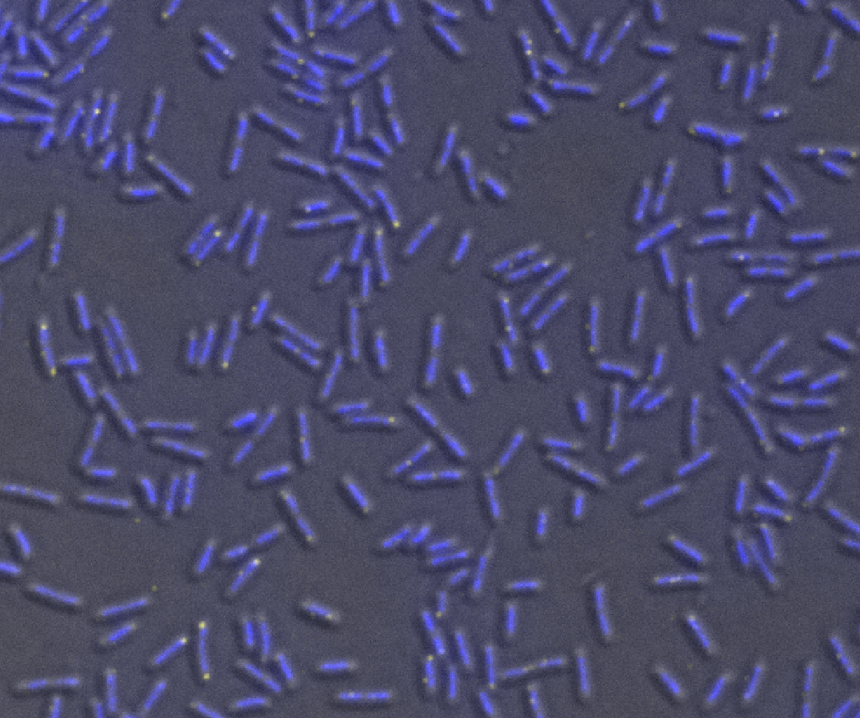
Localization of hipBA mRNAs
hipBA is often close to the nucleoid tip
hipBA
Notes:
Caption: hipBA is often located at the tip of a nucleoid. The picture shown here was in glycerol condition, but the same was observed in other conditions

Slide 33
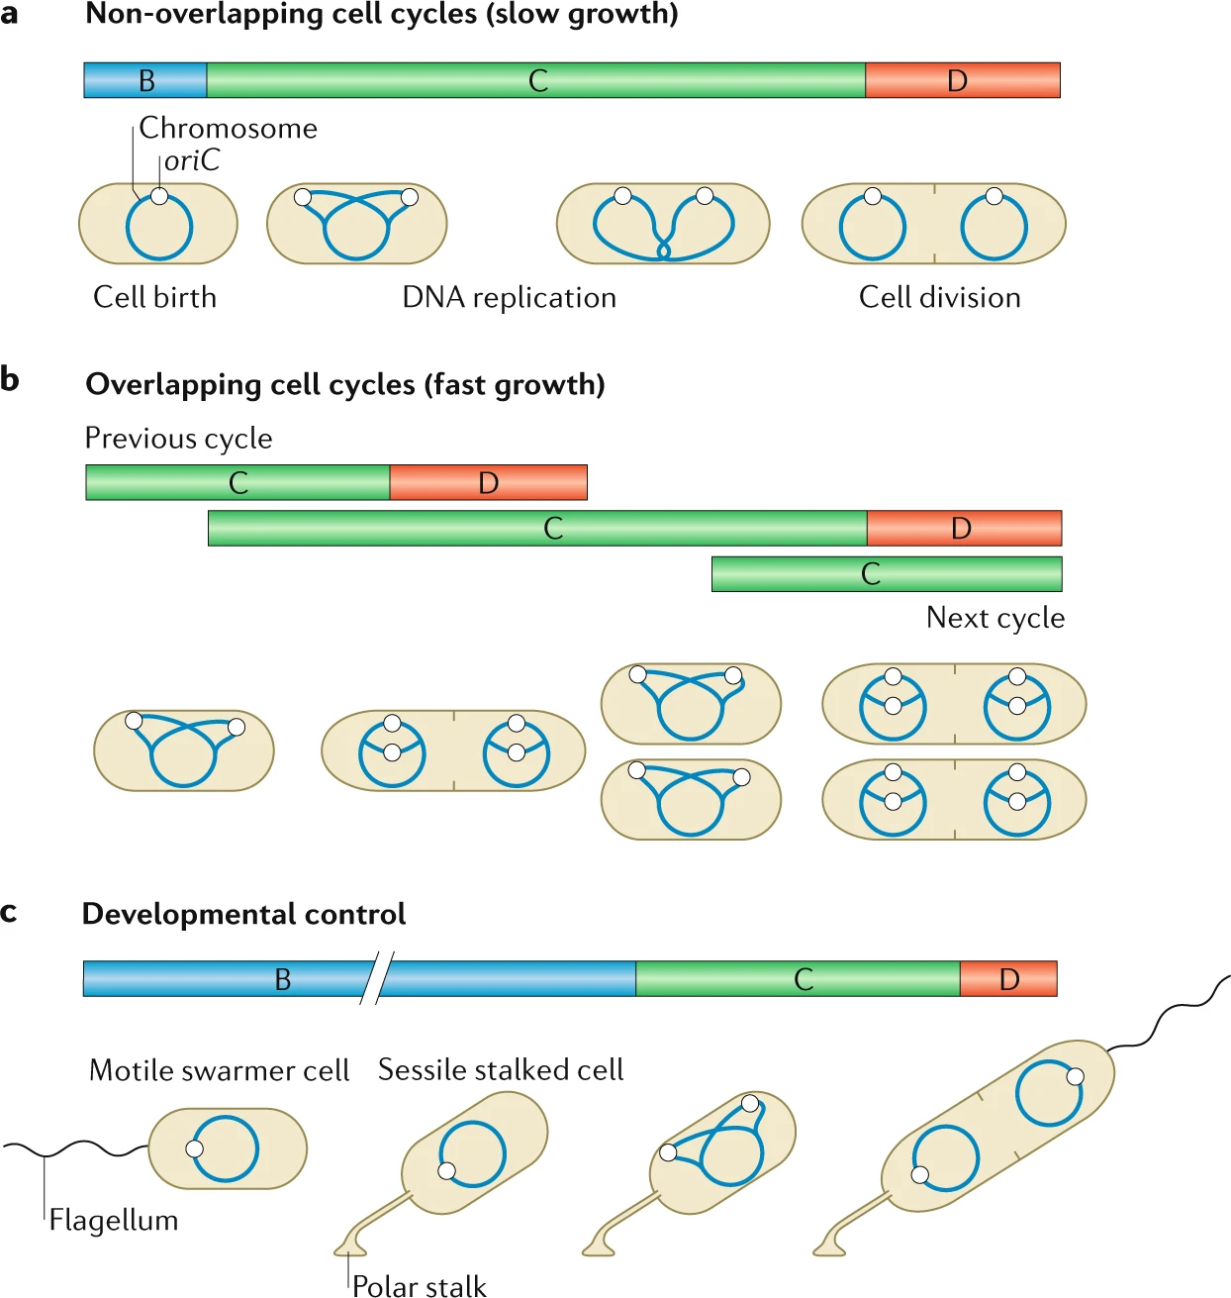
Genome copy number
Genome copy number increases with growth rate, because of the way replication works
mannose, galactose, glycerol: 1
glucose: 1.8
LB: 4
https://doi-org.vu-nl.idm.oclc.org/10.1038/s41579-019-0212-7

Slide 34
Gene copy number
rpoD
rnlAB
hipBA
Based on numbers from Bremer2008
https://doi.org/10.1128/ecosal.5.2.3
https://doi.org/10.1016/j.molcel.2018.01.003

Slide 35
Gene copy number
rpoD
rnlAB
hipBA
Based on numbers from Bremer2008
https://doi.org/10.1128/ecosal.5.2.3
https://doi.org/10.1016/j.molcel.2018.01.003

Slide 36
RNA polymerase
The rate of transcription in the cell depends on the concentration of RNA polymerase
DNA and σ⁷⁰ are not limiting
Notes:
Bremer2008:
The rate of transcription in the cell depends on the concentration of RNA polymerase.
The amount of $\sigma^{70}$ the housekeeping sigma factor that is employed for most transcription initiation during exponential phase growth, is present in excess over the amount of free (and even total) core RNA polymerase. "As mentioned above, the $\sigma^{70}$ subunit is in excess over free, functional core enzyme (80, 99), suggesting that essentially all free enzyme is functional holoenzyme."
The total rate of transcription in E. coli is not limited by the DNA concentration but is limited by the concentration of free functional RNA polymerase. Which is mysterious given that not all RNAP is active, actually a large part is inactive. "This is perhaps surprising in view of the fact that only a small fraction of the polymerase is actively engaged in transcript elongation at any instant.")

Slide 37
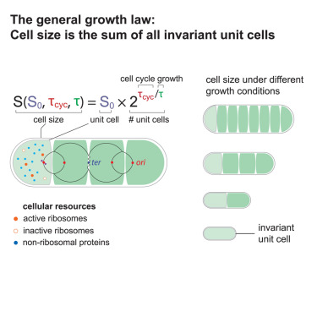
Unit cell size hypothesis
Cell size increases exponentially with growth rate
Gene copy number increases linearly with volume
Notes:
protein concentration was constant from cell to cell despite variation in chromosome copy number and, thus, in gene dosage.
the number of genome copies increased linearly with cell volume in individual cells
cell size added during the replication cycle of one chromosome is invariant regardless of the growth rate
‘general growth law’ that cell size is the sum of all invariant ‘unit cells’, where the number of unit cells is determined by the number of replication origins simultaneously present in the cells

Slide 38
Conclusions
method for performing 3-color smFISH in E.coli
pipeline for quantifying rpoD, hipBA and rnlAB expression
results suggest that:
rpoD expression is growth regulated, whereas TA systems expression does not significantly change with growth rate
gene copy number is roughly proportional to cell volume
hipBA is located at the tip of the nucleoid

Slide 39
Next
cultures
use amino-acids => larger cells => better processing
stress condition
rpoS probes (rpoS: 993 bp)
FISH
fewer unbound rnlAB probes
analysis
more cells
segmentation
post-filtering
brightfield or phase contrast for cell outline
pipeline
try U-FISH
napari plugin
time-lapse experiment
movie on a chip + fixing + FISH
fine-resolution microscopy techniques
expansion
super-resolution

